Slide 1
K-NEAREST NEIGHBOR
Presentation for LA2 Component of Data Mining (18CS54)

Slide 2
Presented by:
Gaurav Raj Shah 1NT18CS195
Abhishek Kushwaha 1NT18CS212
Anand Jaiswal 1NT18CS190
Siddharth Yadav 1NT18CS208
Presented to:
Dr. Vijaya Shetty
Professor, Dept. of CSE, NMIT, Bangalore

Slide 3
PROBLEM STATEMENT
To classify any given dataset into n classes making use of K-nearest neighbor algorithm.
Our approach:
Here, for classification, any random dataset can be chosen.
We, for instance, are using a template dataset named classified dataset which is provided with 10 different features.
This dataset can be replaced with any dataset for example iris plant dataset.
We are classifying based on their features, whether it is an iris flower or not.
There are many classification algorithm that can be used for the following but k-nearest is one of the simplest and widely used algorithm for this kind of tasks.

Slide 4
HW & SW Requirements
Hardware:
Any modern computing device supporting python and its complementary libraries: x86 64-bit CPU (Intel / AMD architecture)
Having approximately 1 GB of RAM.
1GB free disk space.
Software:
Any modern operating system(Windows/Linux/Mac).
Python
Pandas
Seaborn
Matplotlib
NumPy

Slide 5
INTRODUCTION
k-nearest neighbors algorithm (k-NN) is a non-parametric machine learning method first developed by Evelyn Fix and Joseph Hodges in 1951, and later expanded by Thomas Cover.
k-NN is a type of instance-based learning, or lazy learning, where the function is only approximated locally, and all computation is deferred until function evaluation.
It is a simple, easy-to-implement supervised machine learning algorithm that can be used to solve both classification and regression problems.
In k-NN classification, the output is a class membership. An object is classified by a plurality vote of its neighbors, with the object being assigned to the class most common among its k nearest neighbors (k is a positive integer, typically small).
In k-NN regression, the output is the property value for the object. This value is the average of the values of k nearest neighbors.

Slide 6
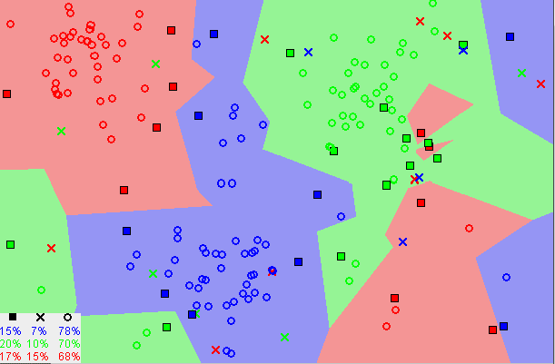

Slide 7
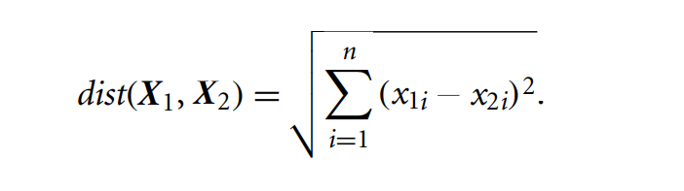
INTRODUCTION
“Closeness” is defined in terms of a distance metric, such as Euclidean distance. The Euclidean distance between two points or tuples, say, X₁ = (x₁₁, x₁₂, ... , x_{1n}) and X₂ = (x₂₁, x₂₂, ... , x_{2n}), is
The neighbors are taken from a set of objects for which the class (for k-NN classification) or the object property value (for k-NN regression) is known. This can be thought of as the training set for the algorithm, though no explicit training step is required.
A peculiarity of the k-NN algorithm is that it is sensitive to the local structure of the data.

Slide 8


Slide 9
ALGORITHM
Step 1: Load the data.
Step 2: Initialize K to your chosen number of neighbors.
Step 3: For each example in the data do step 4 to 10.
Step 4: Calculate the distance between the query example and the current example from the data.
Step 5: Add the distance and the index of the example to an ordered collection.
Step 6: Sort the ordered collection of distances and indices from smallest to largest (in ascending order) by the distances.
Step 7: Pick the first K entries from the sorted collection.
Step 8: Get the labels of the selected K entries.
Step 9: If regression, return the mean of the K labels.
Step 10: If classification, return the mode of the K labels.

Slide 10
CHOOSIGN RIGHT VALUE OF K
The value of K can be determined experimentally. Starting with k = 1, we use a test set to estimate the error rate of the classifier. This process can be repeated each time by incrementing k to allow for one more neighbor.
The k value that gives the minimum error rate may be selected. In general, the larger the number of training tuples, the larger the value of k will be (so that classification and numeric prediction decisions can be based on a larger portion of the stored tuples).
Inversely, as we increase the value of K, our predictions become more stable due to majority voting / averaging, and thus, more likely to make more accurate predictions (up to a certain point). Eventually, we begin to witness an increasing number of errors. It is at this point we know we have pushed the value of K too far.
In cases where we are taking a majority vote (e.g., picking the mode in a classification problem) among labels, we usually make K an odd number to have a tiebreaker..

Slide 11
PROS vs CONS
Advantages
Disadvantages
The algorithm is simple and easy to implement.
There is no need to build a model, tune several parameters, or make additional assumptions.
This algorithm is versatile as it can be used for classification, regression, and search problems.
The algorithm gets significantly slower as the number of examples and/or predictors/independent variables increase.

Slide 12
REAL WORLD APPLICATIONS
KNN can be used for Recommendation Systems. Although in the real world, more sophisticated algorithms are used for the recommendation system. KNN is not suitable for high dimensional data, but KNN is an excellent baseline approach for the systems. Many companies make a personalized recommendation for its consumers, such as Netflix, Amazon, YouTube, and many more.
KNN can search for semantically similar documents. Each document is considered as a vector. If documents are close to each other, that means the documents contain identical topics.
KNN can be effectively used in detecting outliers. One such example is Credit Card fraud detection.

Slide 13
CONCLUSION
K- Nearest Neighbors (KNN) identifies the nearest neighbors given the value of K. It is lazy learning and non-parametric algorithm. KNN works on low dimension dataset while faces problems when dealing with high dimensional data.

Slide 14
REFERENCES
Textbook: Jiawei Han and Micheline Kamber: Data Mining - Concepts and Techniques, 3rd Edition, Morgan Kaufmann Publisher, 2014
Textbook: Pang-Ning Tan, Michael Steinbach, Vipin Kumar: Introduction to Data Mining (1st Edition)
Paper: Pádraig Cunningham, Sarah Jane Delany (29 Apr 2020) k-Nearest Neighbor Classifiers 2nd Edition (with Python examples).
Wikipedia - https://en.wikipedia.org/wiki/K-nearest_neighbors_algorithm
Article on K-Nearest Neighbors (KNN) algorithm (Towards Data Science) - https://towardsdatascience.com/k-nearest-neighbors-knn-algorithm-23832490e3f4
Article on K-Nearest Neighbors (KNN) algorithm - https://www.geeksforgeeks.org/k-nearest-neighbours/

